Slide 1

Data Preprocessing

Slide 2
Why?
Real-world data is often incomplete, inconsistent, and/or lacking in certain behaviors or trends, and is likely to contain many errors.
Data preprocessing prepares raw data for further processing

Slide 3
Handling Null Values

Slide 4
In any real world dataset there are always few null values.
It doesn’t really matter whether it is a regression, classification or any other kind of problem, no model can handle these NULL or NaN values on its own so we need to intervene.
The easiest way to solve this problem is by dropping the rows or columns that contain the null values.

Slide 5
Imputation
The process of substituting the missing values of our dataset
Common strategies
Mean
Median
Mode

Slide 6
Standardization

Slide 7
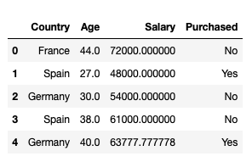
Consider the above data frame, here we have 2 numerical values “Age” and “Salary”.
They are not on the same scale as Age is in years and Salary is in dollars and since Salary will always be greater than Age
Therefore, our model will give more weightage to salary which is not the ideal scenario as age is also an integral factor here.

Slide 8
Goal
Change the values of numeric columns in the dataset to use a common scale, without distorting differences in the ranges of values or losing information.

Slide 9
Mean of the values is 0
Standard deviation is 1

Slide 10
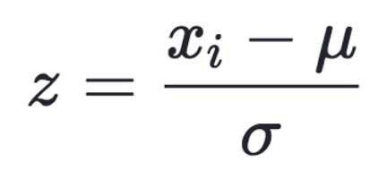

Slide 11
Handling Categorical Variables

Slide 12
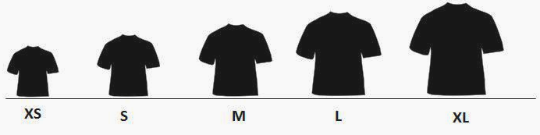
Ordinal Categorical Variables
These variables can be ordered.
Ex: Size of a t-shirt. We can say M<L<XL

Slide 13

Nominal Categorical Variables
No concept of ordering amongst the values of that attribute.

Slide 14
Integer Encoding
Each unique category value is assigned an integer value
The integer values have a natural ordered relationship between each other and machine learning algorithms may be able to understand and harness this relationship

Slide 15
One-Hot Encoding
For categorical variables where no such ordinal relationship exists, the integer encoding is not enough.
Using this encoding and allowing the model to assume a natural ordering between categories may result in poor performance or unexpected results.
In this case, a one-hot encoding can be applied to the integer representation. This is where the integer encoded variable is removed and a new binary variable is added for each unique integer value.

Slide 16
So in One-Hot Encoding what we essentially do is that we create ‘n’ columns where n is the number of unique values that the nominal variable can take.
So out of the n columns only one column can have value = 1 and the rest all will have value = 0.
India | 1 | 0 | 0
China | 0 | 1 | 0
Pakistan | 0 | 0 | 1

Slide 17
Splitting the Data

Slide 18
When you’re working on a model and want to train it, you obviously have a dataset. But after training, we have to test the model on some test dataset.
But it might not always be possible to have so much data during the development phase.
In such cases, the obviously solution is to split the dataset you have into two sets, one for training and the other for testing.

